Slide 1

Long Range Planning Advisory Committee
Final Report
July 13, 2017 - School Board Meeting

Slide 2
Committee Overview
Purpose
Per Policy FB: “The Long-Range Planning Advisory Committee (LRPAC) is formed to inform and advise the Superintendent and School Board in the development of comprehensive, long-term plans for facilities needs in the most effective and efficient way and in support of the School Division’s Strategic Plan.”
Membership
School Board Appointees Superintendent Appointees
Tammie Moses, Jouett District Jason Handy
Andrea Mejia, Rio District Jon Stokes
Daniel Steeper, Rivanna District Randall Switz
JR Washington, Samuel Miller District William Coles
CJ Hatcher, White Hall District Kate Barrett
Daisy Rojas, At-Large

Slide 3
Staff Support
Central Office
Building Services
Transportation
Local Government
Rosalyn Schmitt, Asst. Director of Facilities Planning
Patrick McLaughlin, Strategic Planning Officer
Joe Letteri, Director
George Shifflett, Deputy Director
Sheila Hoopmann, Capital Projects Manager
Jim Foley, Director
Renee DeVall, Transportation Analyst
Montie Breeden, Senior Project Manager

Slide 4
The CIP Review Process
July:
LRPAC Recommendation
August:
Staff Presentation & School Board Approval
October:
Technical Review Committee & Financial Review Committee
January - February:
Executive Office
February - April:
Board of Supervisors
April:
Approved CIP
November:
Joint Board Meeting & Planning Commission
December:
Oversight Committee
Notes:
BOS may change. Will know more in September

Slide 5

Key Topics
Bond Referendum
Building Capacity Revisions
Market Conditions & Cost Increases
Project Timing/Appropriations
Mobile Classrooms

Slide 6
Key Topics – Project Timing
A change in the timing of project appropriations has influenced the fiscal year in which a project is requested.
All construction requests are requested one fiscal year earlier than in the past.
Design and construction are requested in the same fiscal year.

Slide 7
Key Topics – Project Timing (cont.)
Project Type | Previous Request | Current Request
Summer Work | FY18/19 | FY17/18
Design | FY17/18 | FY17/18
Construction | FY18/19 | FY17/18

Slide 8
Key Topics – Mobile Classrooms

Slide 9
Boundary Changes – Watch List
This CIP recommendation is based on assumptions that future redistricting will impact the following schools/areas in the next 10 years:
Greer, Agnor-Hurt, Woodbrook Elementary Schools
Baker-Butler Elementary School
Walton Middle School
Western Feeder Pattern Elementary Schools

Slide 10
FY19 Capital Improvement Program (CIP) Recommendation

Slide 11
Maintenance/Continuation Projects
Project |  | 1 | 2 | 3 | 4 | 5 | 5 Year Total
 |  | 18/19 | 19/20 | 20/21 | 21/22 | 22/23
M1 | Maintenance/Replacement Program | $7,392 | $8,112 | $8,664 | $7,721 | $9,587 | $41,476
M2 | State Technology Grant | $700 | $700 | $700 | $700 | $700 | $3,500
M3 | Instructional Technology | $575 | $575 | $575 | $575 | $575 | $2,875
M4 | Administrative Technology | $263 | $263 | $263 | $263 | $263 | $1,315
M5 | Telecommunications Network Upgrade | $150 | $900 | $150 | $150 | $900 | $2,250
M6 | School Bus Replacements | $1,200 | $1,200 | $1,200 | $1,200 | $1,200 | $6,000
(Amounts in thousands)
No change from previous requests

Slide 12
Maintenance Replacement Program
Key Changes
Acceleration of the Kitchen Air Conditioning Installations
Updated estimates on HVAC work
Program is updated each year. See Appendix C for details of new, eliminated and changed projects.
FY19-23: $3.7M Increase (9%)*
*Project to project difference is less. Year to year comparison misleading due to appropriation timing changes

Slide 13
Technology Projects
State Technology Grant
- Decreased by $26,000/year due to closure of Yancey
Telecommunications Network Upgrade
- Previously $900k requested every three years
- Additional $150k requested in intermediate years for ongoing maintenance of the network.
- Total 5 year increase: $450k

Slide 14
Non-Maintenance Projects
Project |  | 1 | 2 | 3 | 4 | 5 | 5 Year Total
 |  | 18/19 | 19/20 | 20/21 | 21/22 | 22/23
1 | High School Improvements* | TBD | TBD | TBD | TBD | TBD | TBD
2 | Learning Space Modernization | $6,250 | $6,015 | $5,002 | $4,319 | $4,319 | $25,905
3 | Scottsville Additions & Improvements | $12,300 |  | open |  |  | $12,300
4 | Crozet Addition & Improvements |  | $9,700 |  | open |  | $9,700
5 | Red Hill Phase 2 |  | $5,500 |  | open |  | $5,500
(Amounts in thousands)
*Contingent on consultant study scheduled to be complete in Fall 2017

Slide 15
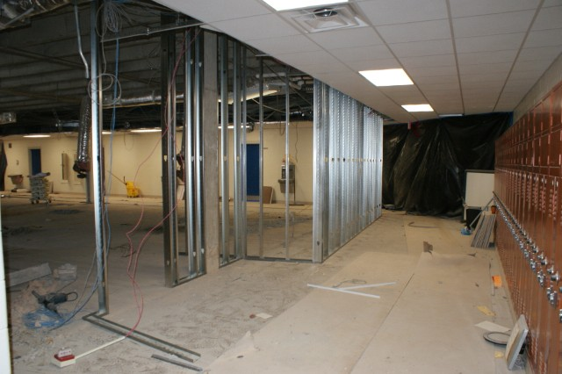
Learning Space Modernization
2
WAHS Classroom Modernization underway

Slide 16
Learning Space Modernization
2
SCOPE
Improvements to existing instructional spaces including classrooms, libraries, and other elective and instructional support areas.
Modifications will include furniture and renewal work including improving daylighting, updating finishes, casework, lighting, technology and power, and connections to adjacent spaces.
BUDGET
$25.9M (5 years only)
SCHEDULE
Ongoing
CHANGES FROM PREVIOUS REQUESTS
This project is for Middle and Elementary Schools only
Estimates have been increased to reflect current bidding climate and to include technology equipment.

Slide 17
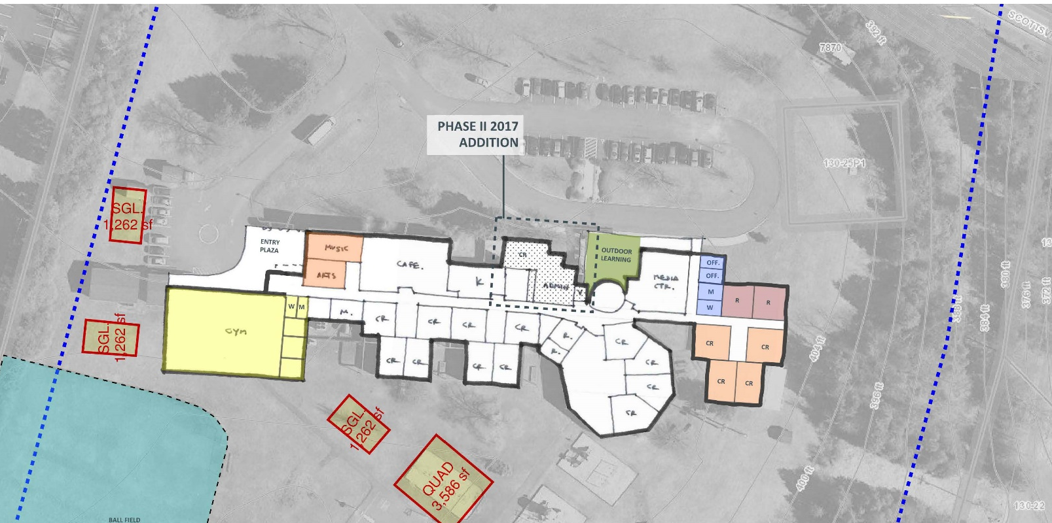

Scottsville Addition & Improvements
3

Slide 18
Scottsville Addition & Improvements
3
BUDGET
$12.3M
SCHEDULE
Open 2020/21 School Year
CHANGES FROM PREVIOUS REQUESTS
Accelerated, increased priority
Added gym & improvements to existing building
Added septic system replacement
Estimates updated to reflect current construction costs
SCOPE
Addition(s) - 20,000 sf
4 additional classrooms
2 smaller resource classrooms
2 offices
Full-size gym
Site improvements
Outdoor learning areas
Septic system replacement
Improvements to the existing building

Slide 19
Crozet Addition & Improvements
4

Slide 20
Crozet Addition & Improvements
4
BUDGET
$9.7M
SCHEDULE
Open 2021/22 School Year
CHANGES FROM PREVIOUS REQUESTS
Accelerated
Added improvements to existing building
Estimates updated to reflect current construction costs
SCOPE
Addition(s) - 16,000 sf
8 additional classrooms
3 smaller resource classrooms
2 offices
Support spaces
Site improvements
Outdoor learning areas
Additional parking & play areas
Improvements to the existing building

Slide 21
Red Hill – Phase 2
5

Slide 22
Red Hill – Phase 2
5
BUDGET
$5.5M
SCHEDULE
Open 2021/22 School Year
CHANGES FROM PREVIOUS REQUESTS
Increased size of the gym addition
Estimates updated to reflect current construction costs
SCOPE
Addition(s) – 8,800 sf
Full-size gym + support spaces
Site improvements
Outdoor learning areas
Additional parking
Improvements to the existing building
Repurpose old gym
Cafeteria, toilets, kitchen, etc.
Exterior fascia/soffit repair

Slide 23
Options/Variations to Discuss Further
Scale/magnitude of improvements to existing buildings
Number of classrooms at Scottsville or Crozet
Size of the gym: school need vs. community use

Slide 24
FY 19 CIP Recommendation
Project |  | 1 | 2 | 3 | 4 | 5 | 5 Year
 |  | 18/19 | 19/20 | 20/21 | 21/22 | 22/23 | Total
M1 | Maintenance/Replacement Program | $7,392 | $8,112 | $8,664 | $7,721 | $9,587 | $41,476
M2 | State Technology Grant | $700 | $700 | $700 | $700 | $700 | $3,500
M3 | Instructional Technology | $575 | $575 | $575 | $575 | $575 | $2,875
M4 | Administrative Technology | $263 | $263 | $263 | $263 | $263 | $1,315
M5 | Telecommunications Network Upgrade | $150 | $900 | $150 | $150 | $900 | $2,250
M6 | School Bus Replacements | $1,200 | $1,200 | $1,200 | $1,200 | $1,200 | $6,000
1 | High School Improvements | TBD | TBD | TBD | TBD | TBD | TBD
2 | Learning Space Modernization | $6,250 | $6,015 | $5,002 | $4,319 | $4,319 | $25,905
3 | Scottsville Additions & Improvements | $12,300 |  |  |  |  | $12,300
4 | Crozet Addition & Improvements |  | $9,700 |  |  |  | $9,700
5 | Red Hill Phase 2 |  | $5,500 |  |  |  | $5,500
TOTAL |  | $28,830 | $32,965 | $16,554 | $14,928 | $17,544 | $110,821

Slide 25
FY19 Capital Needs Assessment (CNA) Recommendation

Slide 26
CNA Recommendation: FY23/24 – FY27/28
PROJECT |  | 6 | 7 | 8 | 9 | 10 | 5 Year
 |  | 23/24 | 24/25 | 25/26 | 26/27 | 27/28 | Total
M1 | Maintenance/Replacement Program | $10,000 | $10,000 | $10,000 | $10,000 | $10,000 | $50,000
M2 | State Technology Grant | $700 | $700 | $700 | $700 | $700 | $3,500
M3 | Instructional Technology | $575 | $575 | $575 | $575 | $575 | $2,875
M4 | Administrative Technology | $263 | $263 | $263 | $263 | $263 | $1,315
M5 | Telecommunications Network Upgrade | $150 | $900 | $150 | $150 | $900 | $2,250
M6 | School Bus Replacements | $1,200 | $1,200 | $1,200 | $1,200 | $1,200 | $6,000
1 | Learning Space Modernization | $5,000 | $5,000 | $5,000 | $5,000 | $5,000 | $25,000
2 | Administration Space | $7,000 |  |  |  |  | $7,000
3 | New Elementary School |  |  | $20,000 |  |  | $20,000
4 | CATEC |  |  |  | TBD |  | TBD
5 | Middle School Addition(s) |  |  |  |  | TBD | TBD
TOTAL |  | $24,888 | $18,638 | $37,888 | $17,888 | $18,638 | $117,940

Slide 27
Questions?

